Slide 1
Path Integral Methods for Light Transport Simulation Theory & Practice
Jaroslav Křivánek
Charles University Prague
Iliyan Georgiev
Light Transporttion, Ltd.
Anton Kaplanyan
KIT
Juan Cañada
Next Limit Technologies

Slide 2
INTRODUCTION
Jaroslav Křivánek
Charles University in Prague

Slide 3
Origin of this tutorial
SIGGRAPH 2013 course:
“Recent advances in light transport simulation: Theory & Practice”
Notes:
This tutorial is derived from the SIGGRAPH 2013 course with the title “Recent advances in light transport simulation: Theory & Practice”
When I first though about proposing that course, I wanted to give it a title that read „Path integral formulation of light transport and applications“.
The co-presenters advised me that this would be a bit too technical and could scare people away.
So we changed the title for the SIGGRAPH submission, but in fact, the course content hasn’t changed much at all: it still put a lot of emphasis on the path integral formulation of light transport and all the great algorithms it allows us to develop.
For tutorial we felt a bit bolder and put the “path integral” right in the title. After all, that is what we will be talking about most of the time.

Slide 4
Light transport – Global illumination
Archviz
Movies
© Duncan Howdin
Image courtesy of Columbia Pictures. © 2006 Columbia Pictures Industries, Inc.
Notes:
Light transport simulation is an essential component of rendering realistic images with global illumination.
It’s been a standard tool in architectural and product visualization for many years now.
Its use in movies picked up later due to technical difficulties (large scenes, tighter rendering time budget).

Slide 5
Light transport – Global illumination
Movies
2002, Shrek 2 (PDI/Dreamworks)
1 bounce indirect
2006, Monster House (Sony Imageworks)
Full light transport (path traced)
Arnold renderer
Image courtesy of Columbia Pictures. © 2006 Columbia Pictures Industries, Inc.
Notes:
The use of global illumination in feature film production started with PDI/Dreamwork’s Shrek 2. They used irradiance caching to compute a single bounce of diffuse indirect illumination – so not really the full light transport.
The Monster House in 2006 was probably the time that ray-based, accurate Monte Carlo light transport simulation was used in movie production.
It was rendered with the Arnold renderer – a brute force path tracer developed by Marcos Fajardo in collaboration with Sony Imageworks.

Slide 6
Light transport – Global illumination
Movies
2006, Monster House (Sony Imageworks)
Full light transport (path traced)
Arnold renderer
Image courtesy of Columbia Pictures. © 2006 Columbia Pictures Industries, Inc.
Full light transport simulation
Accuracy
Ease of use
Visual consistency
Notes:
Arnold has in fact started a quiet revolution, where most VFX and animation studios are nowadays shifting toward rendering solutions based on physically plausible light transport simulation.
Advantages of this approach are indisputable
improved accuracy
easier rendering set up – no need for specialized solutions for different illumination effects
guaranteed visual consistency – the most important thing in movies!
The shift in movie production toward physically based light transport underlines the importance of research and development in this area. It is also one of the important motivations behind this tutorial.

Slide 7
Light transport – Global illumination
More information
“The State of Rendering”
Full light transport simulation
Accuracy
Ease of use
Visual consistency
Notes:
A fairly detailed account on the state of rendering in the VFX community is given in a recent fxguide article “The State of Rendering”.
They also mention that the Vertex Connection and Merging algorithm will be used in PRMan 19 (http://cgg.mff.cuni.cz/~jaroslav/papers/2012-vcm/index.htm).

Slide 8
Issues in light transport simulation
Robustness
None of the existing algorithms works for all scenes
Notes:
A number of light transport algorithms exist, such as path tracing (PT), bidirectional path tracing (BPT), photon mapping (PM), or Metropolis light transport (MLT); and there are many variants of these algorithms.
However, the single most pressing issue with all of these solutions is that none of them really works for all practical scenes.
In other words, these solutions are not robust enough.
A robust algorithm should be reasonably efficient for any input scene. The current light transport algorithms unfortunately do not exhibit this desirable feature.

Slide 9
Take-home message
Light transport simulation
is not a solved problem
(robustness, efficiency)
Notes:
So in spite of the amazing results that we are able to produce, light transport simulation (and, more generally, rendering) is definitely not a solved problem (despite what we can hear here and there).
We need a robust solution that will minimize all the manual work and parameter tweaking that currently has to go into preparing a scene for rendering.
We also need a general improvement in efficiency such that light transport simulation can be used in interactive application.
I’m not saying this to start on a negative note. On the contrary, I’m saying this to motivate and encourage the present researchers to contribute to the interesting and exciting research area.

Slide 10
Some recent advances
Vertex Connection and Merging (VCM) = BPT + PPM [Georgiev et al. 12], [Hachisuka et al. 12]
Improvements on Metropolis Light Transport [Jakob and Marchner 12], [Lehtinen et al. 13]
Notes:
Recently, there have been some significant advances in improving the robustness of light transport simulation that we will review in this course.
These include for example progressive photon mapping, its robust combination with bidirectional path tracing (dubbed “vertex connection and merging”), as well as advances on Markov Chain Monte Carlo methods (Metropolis Light Transport).

Slide 11
Common denominator
Path integral formulation of light transport [Veach and Guibas 1995], [Veach 1997]
Notes:
The common to most of these techniques is the view of light transport as an integral over a space of paths.
This is why we will put a significant emphasis on this view of light transport in the course.

Slide 12
Why is the path integral view so useful?
Identify source of problems
High contribution paths sampled with low probability
Develop solutions
Advanced, global path sampling techniques
Combined path sampling techniques (MIS)
Notes:
So why is the path integral framework so useful?
First, it allows us to identify the weaknesses of existing algorithms. With a little bit of simplification, we could say that all problems of current light transport solutions boil down to poor path sampling. Specifically, to the fact that some light transport paths that bring significant amount of energy from the light sources to the camera are not sampled with appropriately high probability. This means high estimator variance that produces noise & fireflies in the renderings.
Second, the path integral framework allows us to develop new light transport algorithms based on advanced, global path sampling techniques, such as Metropolis Light Transport. It also provides us with a means of combining different path sampling techniques in a provably good way using Multiple importance sampling.

Slide 13
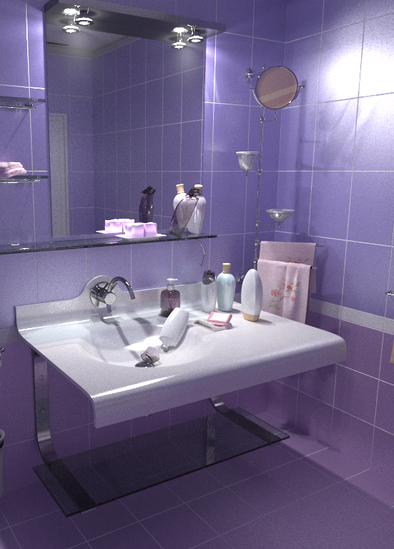
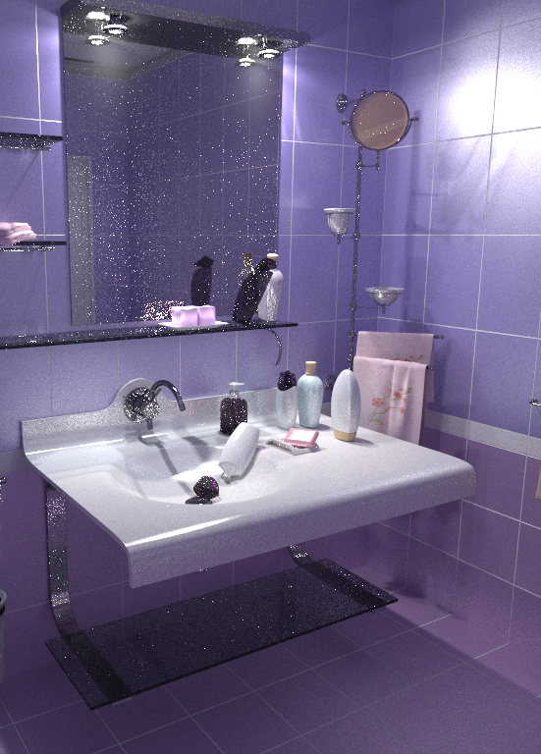
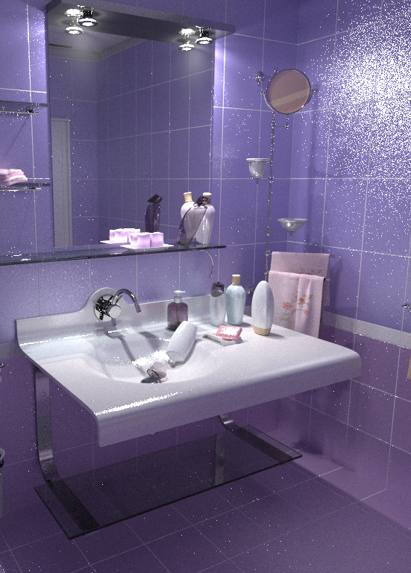
Example: Vertex Connection & Merging (VCM)
SIGGRAPH Asia 2012
VCM
BPT
PPM
Notes:
As an example of the robust combination of path sampling techniques, in the recent Vertex Connection and Merging algorithm, that I co-developed, it was only through re-formulating photon mapping in the path integral framework that we were ably to robustly combine it with bidirectional path tracing and obtain the nice results that you can see on the slide.
So the VCM algorithm is a very tangible example of the strength of the path integral framework.
For more details, see http://cgg.mff.cuni.cz/~jaroslav/papers/2012-vcm/index.htm or the 3rd part of the course.

Slide 14
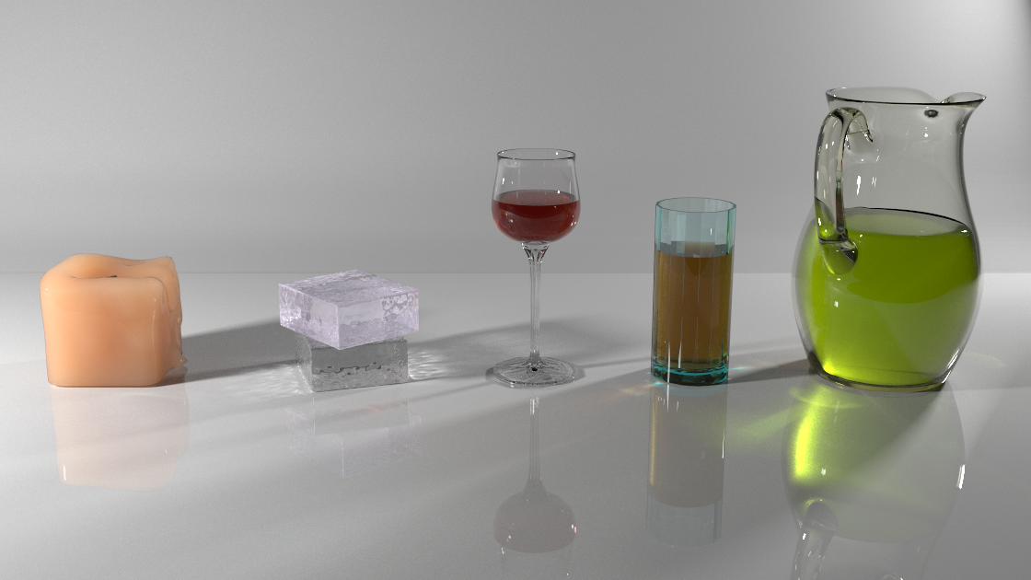
Example: Unified Points, Beams & Paths
SIGGRAPH 2014 (to appear)
Notes:
We have recently extended VCM to participating media and this work just got accepted to SIGGRAPH.
And again, understanding all the existing photon point and photon beams estimators in the path integral framework proved to be essential.

Slide 15
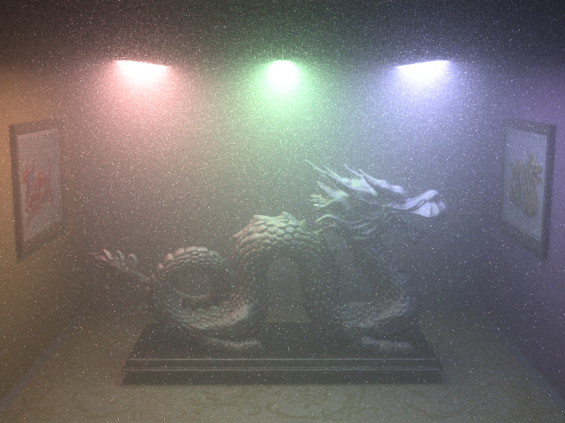
Example: Joint Importance Sampling (JIS)
SIGGRAPH Asia 2013
JIS (new)
prev. work
Notes:
Another example that I co-developed is our work on Joint Importance Sampling for low-order volumetric scattering. Again, it is through a treatment in the path integral framework that we were able to develop new path sampling techniques for low-order scattering in media that achieve orders of magnitude speed-up in some cases.

Slide 16
Course outline
Path Integral Formulation of Light Transport (Jaroslav Křivánek)
Bidirectional Path Sampling Techniques (Jaroslav Křivánek)
Vertex Connection and Merging (Iliyan Georgiev)

Slide 17
Course outline
Markov Chain and Sequential Monte Carlo Methods (Anton Kaplanyan)
Comparison of Advanced Light Transport Methods (Anton Kaplanyan)
Advanced Light Transport in the VFX/Archiviz industry (Juan Cañada)

